Slide 1
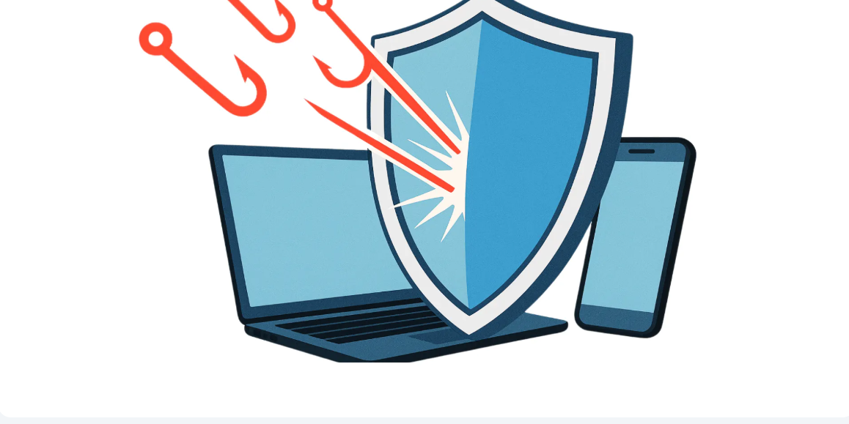

Phishing Awareness Training
Protect Yourself from Cyber Threats

Slide 2
What is Phishing?
Definition: Phishing is a cybercrime where attackers impersonate legitimate organizations to steal sensitive information such as passwords, credit card numbers, and personal data.
Key Statistics:
90% of data breaches start with phishing
1 in 4,200 emails is a phishing attempt
Average cost: $14.8 million per incident

Slide 3
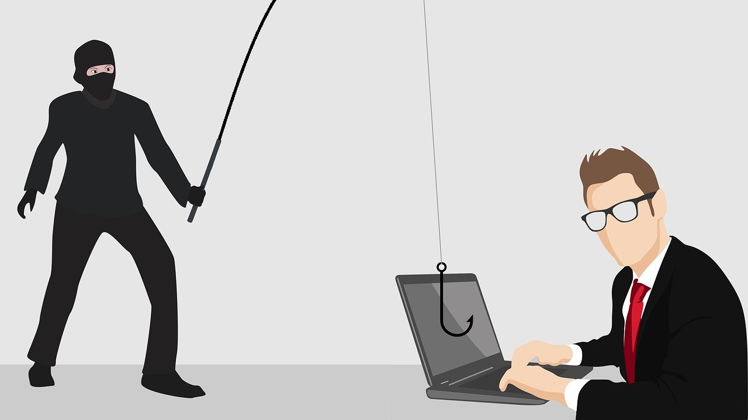
Types of Phishing Attacks
1. Email Phishing
Fraudulent emails appearing to come from trusted sources
2. Spear Phishing
Targeted attacks aimed at specific individuals or organizations
3. Whaling
Attacks targeting high-profile executives (CEOs, CFOs)

Slide 4
Types of Phishing Attacks
4. Smishing (SMS Phishing)
Phishing via text messages
5. Vishing (Voice Phishing)
Phishing through phone calls

Slide 5
Red Flags in Phishing Emails
Warning Signs to Watch For:
✗ Suspicious Sender Address
Look beyond the display name
Check for misspellings: paypa1.com vs paypal.com
✗ Urgent or Threatening Language
"Act now or lose your account!"
"Immediate action required!"

Slide 6
Red Flags in Phishing Emails
✗ Generic Greetings
"Dear Customer" instead of your name
✗ Suspicious Links & Attachments
Hover to reveal the real URL
✗ Poor Grammar & Spelling
Professional companies proofread

Slide 7
Real-World Phishing Example
From: security-alert@bankofamerica-verify.com
Subject: URGENT: Suspicious Activity Detected
Dear Valued Customer,
We have detected unusual activity on your account.
For your security, we have temporarily suspended
your online banking access.
To restore your account immediately, click below:
[Verify My Account Now]
You must complete this within 24 hours or your
account will be permanently closed.
Bank of America Security Team

Slide 8

Red Flags Identified:
🚨 Fake domain: "bankofamerica-verify.com"
🚨 Generic greeting
🚨 Creates urgency and fear
🚨 Suspicious link
🚨 Threatens account closure

Slide 9
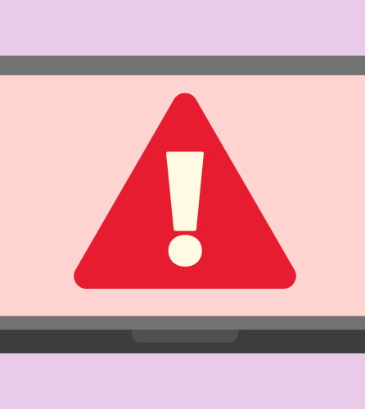
Spotting Fake Websites
Legitimate vs. Phishing URLs
✅ Legitimate: https://www.paypal.com
❌ Phishing: http://paypa1-security.com
❌ Phishing: https://paypal.verify-account.net
Visual Clues:
Missing HTTPS padlock
Misspelled domain names
Extra words or hyphens
Unusual top-level domains (.xyz, .tk)

Slide 10
Social Engineering Tactics
Attackers manipulate human psychology to bypass security
Common Tactics:
🎭 Pretexting - Creating fabricated scenarios Example: "Hi, this is IT. We need your password to fix a server issue."
⚡ Urgency - Creating time pressure Example: "Act in 1 hour or lose your account!"

Slide 11
Social Engineering Tactics
👔 Authority - Impersonating someone in power Example: "This is the CEO, process this wire transfer now."
🎁 Baiting - Offering enticing rewards Example: "You've won a free iPhone!"
😊 Trust - Exploiting relationships Example: "Hey, it's your colleague from HR..."
😨 Fear - Threatening consequences Example: "IRS will file charges unless you pay immediately."

Slide 12
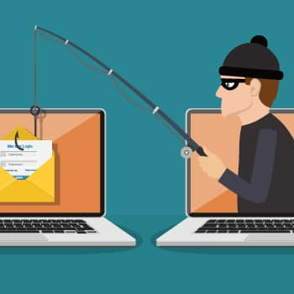
How Phishing Works
Reconnaissance → Attacker gathers information
Email Creation → Crafts convincing fake message
Delivery → Sends to target victims
Victim Action → Clicks link or opens attachment
Data Theft → Credentials stolen or malware installed
Exploitation → Attacker uses stolen information

Slide 13
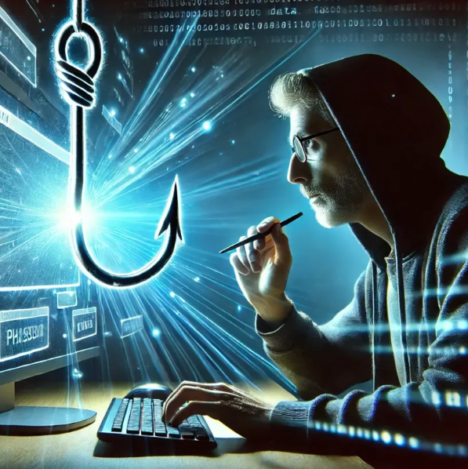
Best Practices Verify Before You Trust
✅ DO:
Hover over links to check the real URL
Contact companies directly using official channels
Type URLs directly into your browser
Verify requests through separate communication
Check sender email addresses carefully

Slide 14
Best Practices Verify Before You Trust
❌ DON'T:
Click links in unexpected emails
Call phone numbers from suspicious emails
Download attachments from unknown sources
Share sensitive info via email
Rush to respond to urgent requests

Slide 15
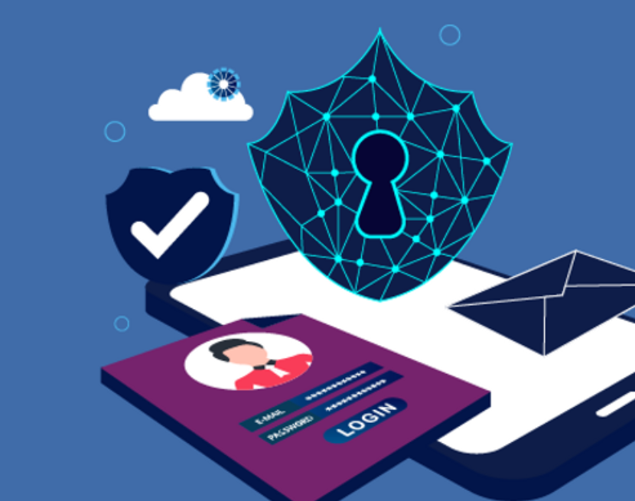
Security Measures
Protect Yourself:
🔐 Multi-Factor Authentication (MFA) Add an extra layer of security to your accounts
🔑 Strong, Unique Passwords Use a password manager for complex passwords
🔄 Regular Updates Keep software and systems up to date
🛡️ Antivirus Software Install and maintain security software
📚 Security Training Stay informed about latest threats

Slide 16
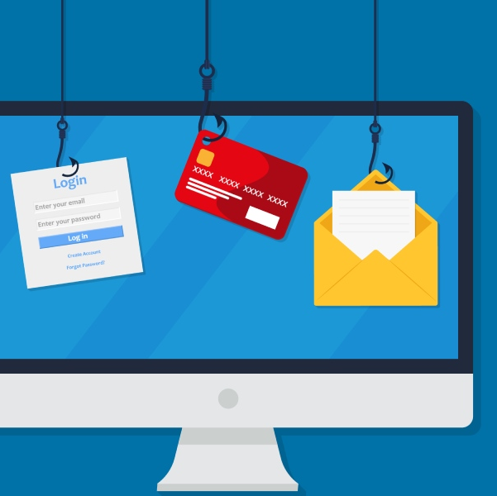
What to Do if You're Targeted
Immediate Actions:
DON'T PANIC - Stay calm and assess
DON'T CLICK - Avoid clicking any links
VERIFY - Contact the company directly
REPORT - Alert your IT/security team
DELETE - Remove the suspicious email
CHANGE PASSWORDS - If you clicked, change credentials
MONITOR - Watch for suspicious account activity

Slide 17

Click to Test Your Phishing Knowledge🎣
Click to Test Your Phishing Knowledge🎣

